Slide 1
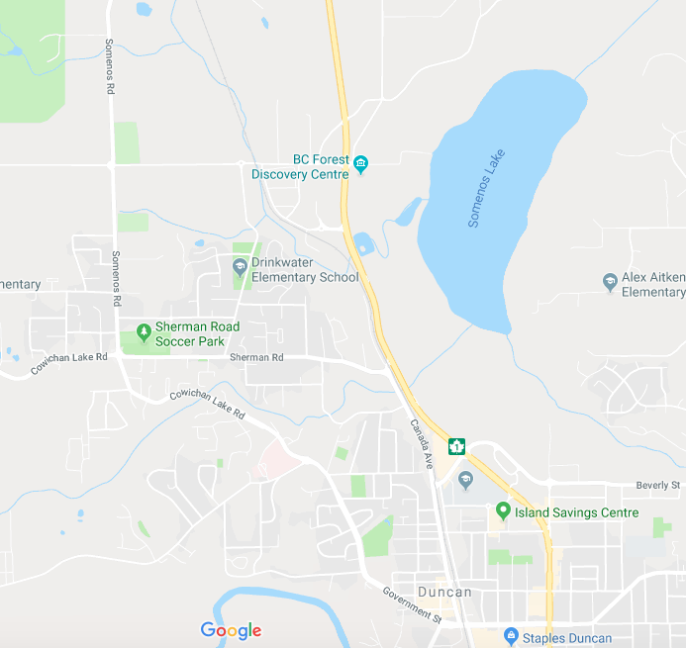
Map Skills
Name:
Directions: Use the map app of the iPad to gather the data
Table 1
Start | Destination | Distance (km) |  | Travel Time hh:mm
 |  | Walking | Driving | Walking | Driving
Drinkwater Elementary | Quamichan School | 3.2 | 3.4 | 00:41 | 00:05
Drinkwater Elementary | VIU Cowichan Campus
Drinkwater Elementary | Cowichan Hospital
Drinkwater Elementary | RCMP Station
Drinkwater Elementary | Staples
Which place was the longest walking distance ?
Destination | km
Which place was the shortest walking distance ?
Destination | km
What was the difference between the longest and shortest walking distances?
km
Why do you think the walking distances were shorter than the driving distances?
Use your home address for this next part
Table 2
Start | Destination | Distance (km) |  | Travel Time hh:mm
 |  | Walking | Driving | Driving | Walking
My House | VIU Cowichan Campus
My House | Cowichan Hospital
My House | RCMP Station
My House | Staples
Which place was the longest driving distance ?
Destination | km
Which place was the shortest driving distance ?
Destination | km
What was the difference between the longest and shortest driving distances?
km

Slide 2
Map Skills
Table 3
Start | Destination | Distance (km) | Travel Time hh:mm
 |  | Driving | Driving
Drinkwater Elementary | Nanaimo, B.C.
Drinkwater Elementary | Victoria, B.C.
Drinkwater Elementary | Ottawa, ON
Drinkwater Elementary | Yellowknife, NWT
Drinkwater Elementary | Montreal, QC
Which destination is furthest away?
Which direction is it? (north, south, east, west)
Table 4
Start | Destination | Distance (km) | Travel Time hh:mm
 |  | Driving | Driving
Frankfurt, Germany | Paris, France
Brussels, Belgium | Bern, Switzerland
Cape Town, South Africa | Cairo, Egypt
Mumbai, India | Bangkok, Thailand
Which had the greatest distance?
Start | Destination
Which had the shortest distance?
Start | Destination

Slide 3
Map Skills
Sort the distance or time from Table 1 in longest to shortest
Table 5
Start | Destination | Distance (km) |  | Travel Time hh:mm
 |  | Walking | Driving | Walking | Driving
Drinkwater Elementary
Drinkwater Elementary
Drinkwater Elementary
Drinkwater Elementary
Drinkwater Elementary
Sort the distance or time from Table 2 in longest to shortest
Table 6
Start | Destination | Distance (km) |  | Travel Time hh:mm
 |  | Walking | Driving | Driving | Walking
My House
My House
My House
My House

Slide 4
Map Skills
Directions: Use the map app of the iPad to gather the data
Table 1
Start | Destination | Distance (km) |  | Travel Time hh:mm
 |  | Walking | Driving | Walking | Driving
Drinkwater Elementary | Quamichan School | 3.2 | 3.4 | 00:41 | 00:05
Drinkwater Elementary | VIU Cowichan Campus | 2.5 | 2.6 | 00:31 | 00:05
Drinkwater Elementary | Cowichan Hospital | 2.3 | 2.8 | 00:28 | 00:04
Drinkwater Elementary | RCMP Station | 1.5 | 1.6 | 00:18 | 00:02
Drinkwater Elementary | Staples | 3.4 | 3.5 | 00:42 | 00:06
Which place was the longest walking distance ?
Destination Staples | Km 3.4
Which place was the shortest walking distance ?
Destination RCMP | Km 1.5
What was the difference between the longest and shortest walking distances?
1.9 km
Why do you think the walking distances shorter than the driving distances?
Use your home address for this next part
Table 2
Start | Destination | Distance (km) |  | Travel Time hh:mm
 |  | Walking | Driving | Driving | Walking
My House | VIU Cowichan Campus
My House | Cowichan Hospital
My House | RCMP Station
My House | Staples
Which place was the longest driving distance ?
Destination | km
Which place was the shortest driving distance ?
Destination | km
What was the difference between the longest and shortest driving distances?
km

